Slide 1
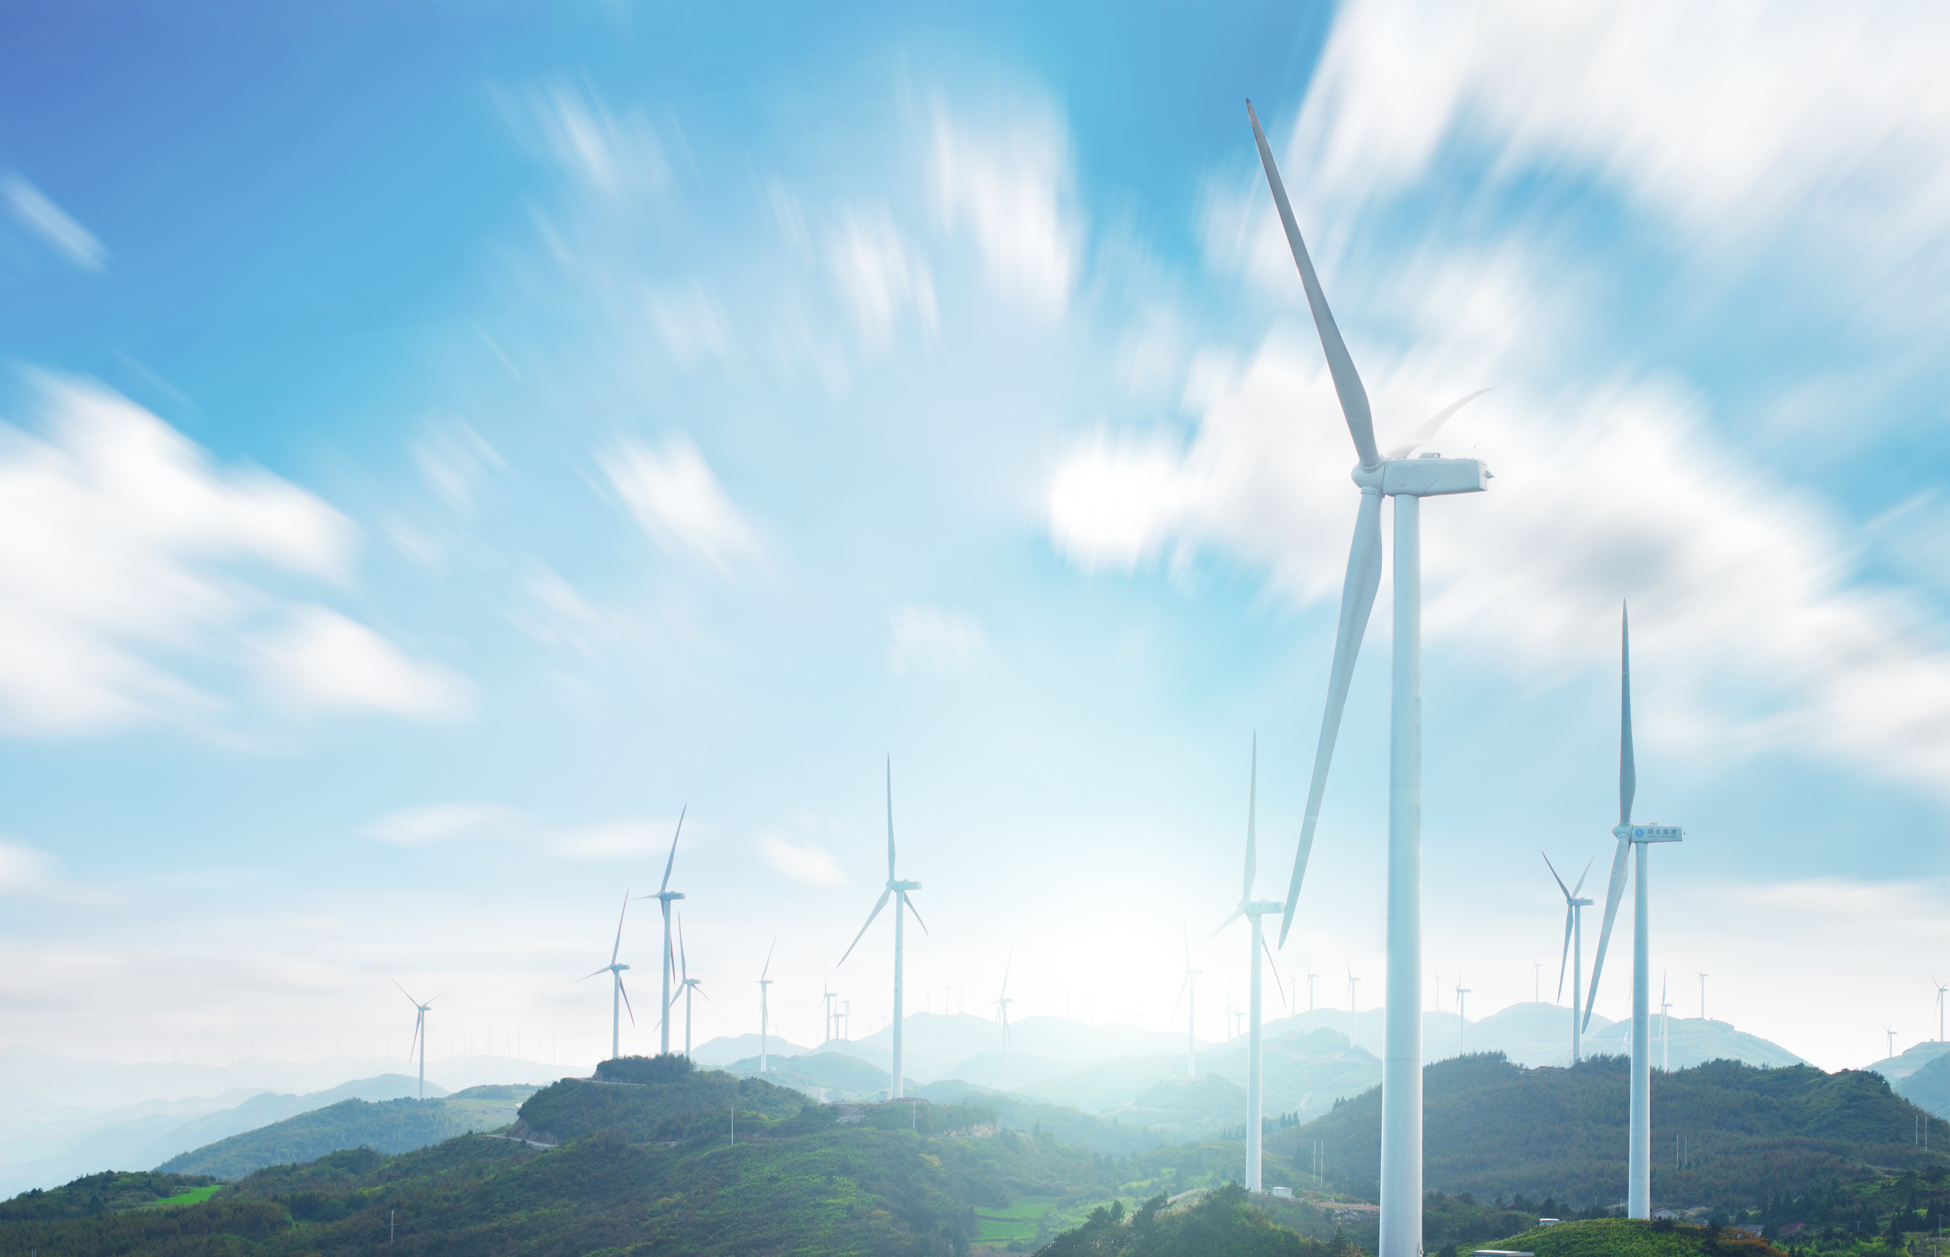


Victoria Mollard | Executive General Manager, Economics and System Security, AEMC
The impact of AI
on energy systems
Australian Energy Market Commission | 22 September 2026

Slide 2
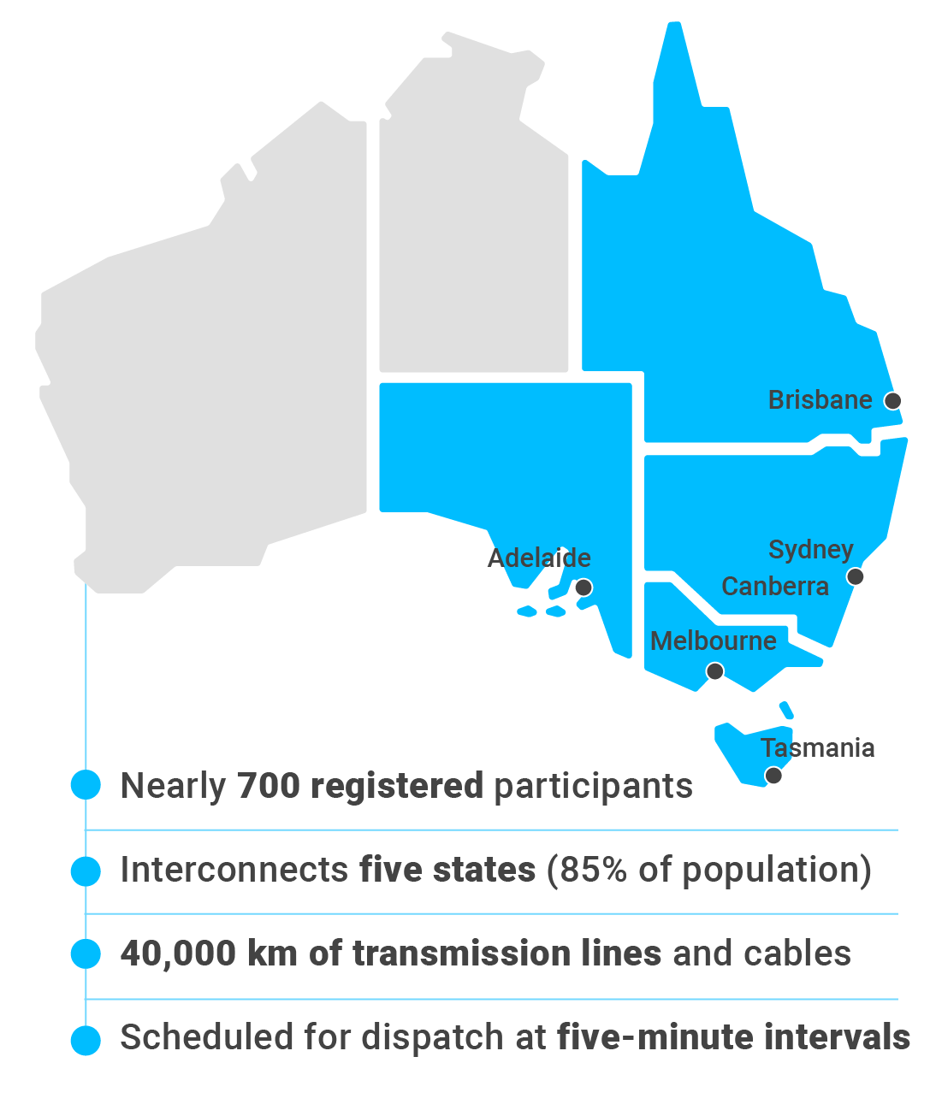
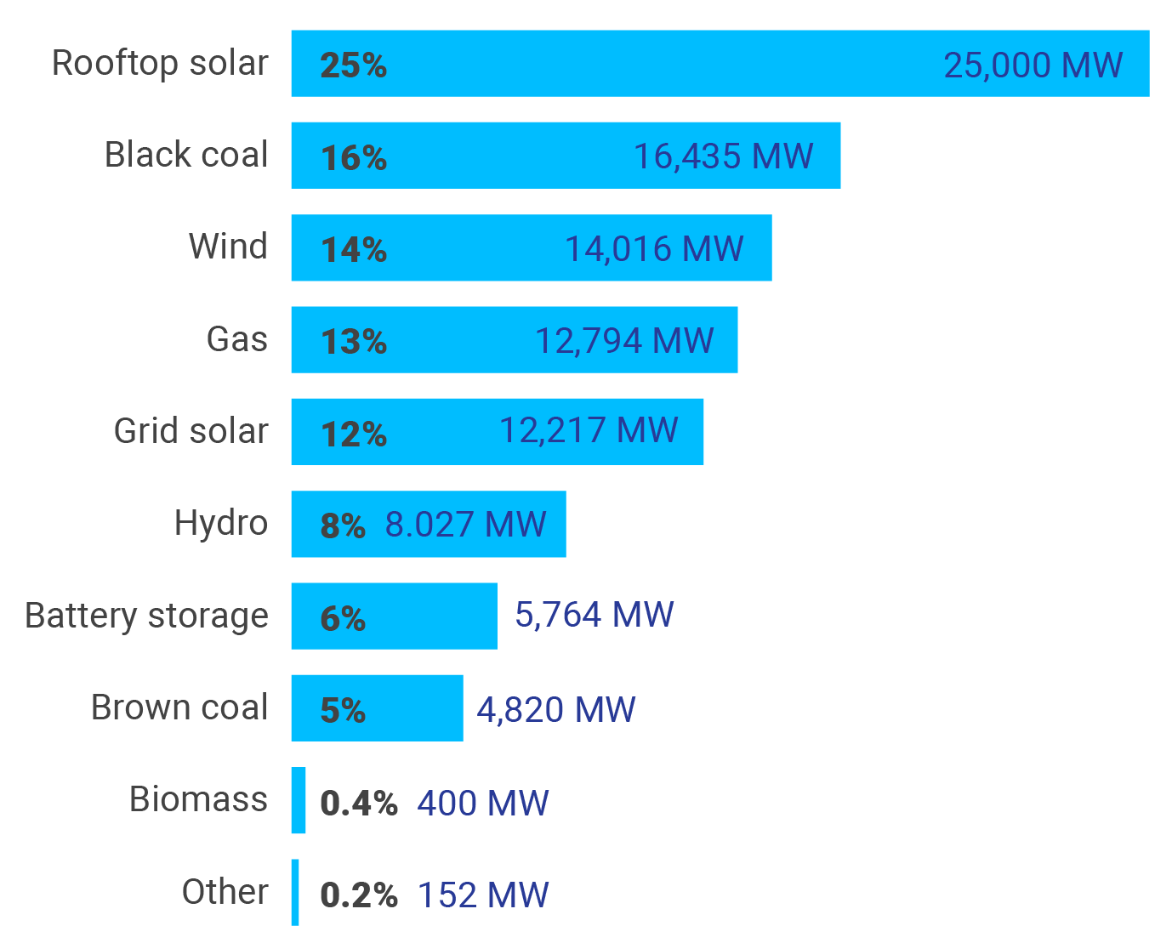
The Australian Energy Market Commission (AEMC)
What we do
National Electricity Market (NEM)
Generation capacity
By fuel type in 2025 (%)
Rule maker, market developer and expert adviser to governments.
Protects consumers and achieves the right trade off between cost, emissions, reliability and security
as sector transitions to net zero.
One of three energy market bodies:
Australian Energy Regulator
(AER)
Australian Energy Market Operator (AEMO)
Source: AEMO

Slide 3
AI is shaping Australia’s energy transition in three important ways
AI as a new source of demand: data centres
AI as an enabler: Consumer energy resources, networks and energy data
AI as a market participant: algorithmic bidding
Projected to reach almost 10% of NEM’s underlying demand by 2050 (four times the share of today).
The AEMC provided targeted advice to Energy Ministers on implementation options for how data centres could bring their own clean, firmed energy, operate flexible and connect efficiently
The AEMC is finalising updated technical standards for large loads, including data centres.
Australia’s energy system
is becoming increasingly decentralised.
The AEMC has introduced several reforms to improve the visibility and integration of consumer energy resources.
AI is beginning to enable these reforms to improve system operation and give consumers more control and better choices in their energy usage.
Automated bidding is beneficial and increasingly necessary.
Adaptive algorithms can learn from competitors.
The NEM has characteristics that make tacit coordination a risk.
The AEMC is examining the issue, but is not claiming it is occurring.

Slide 4
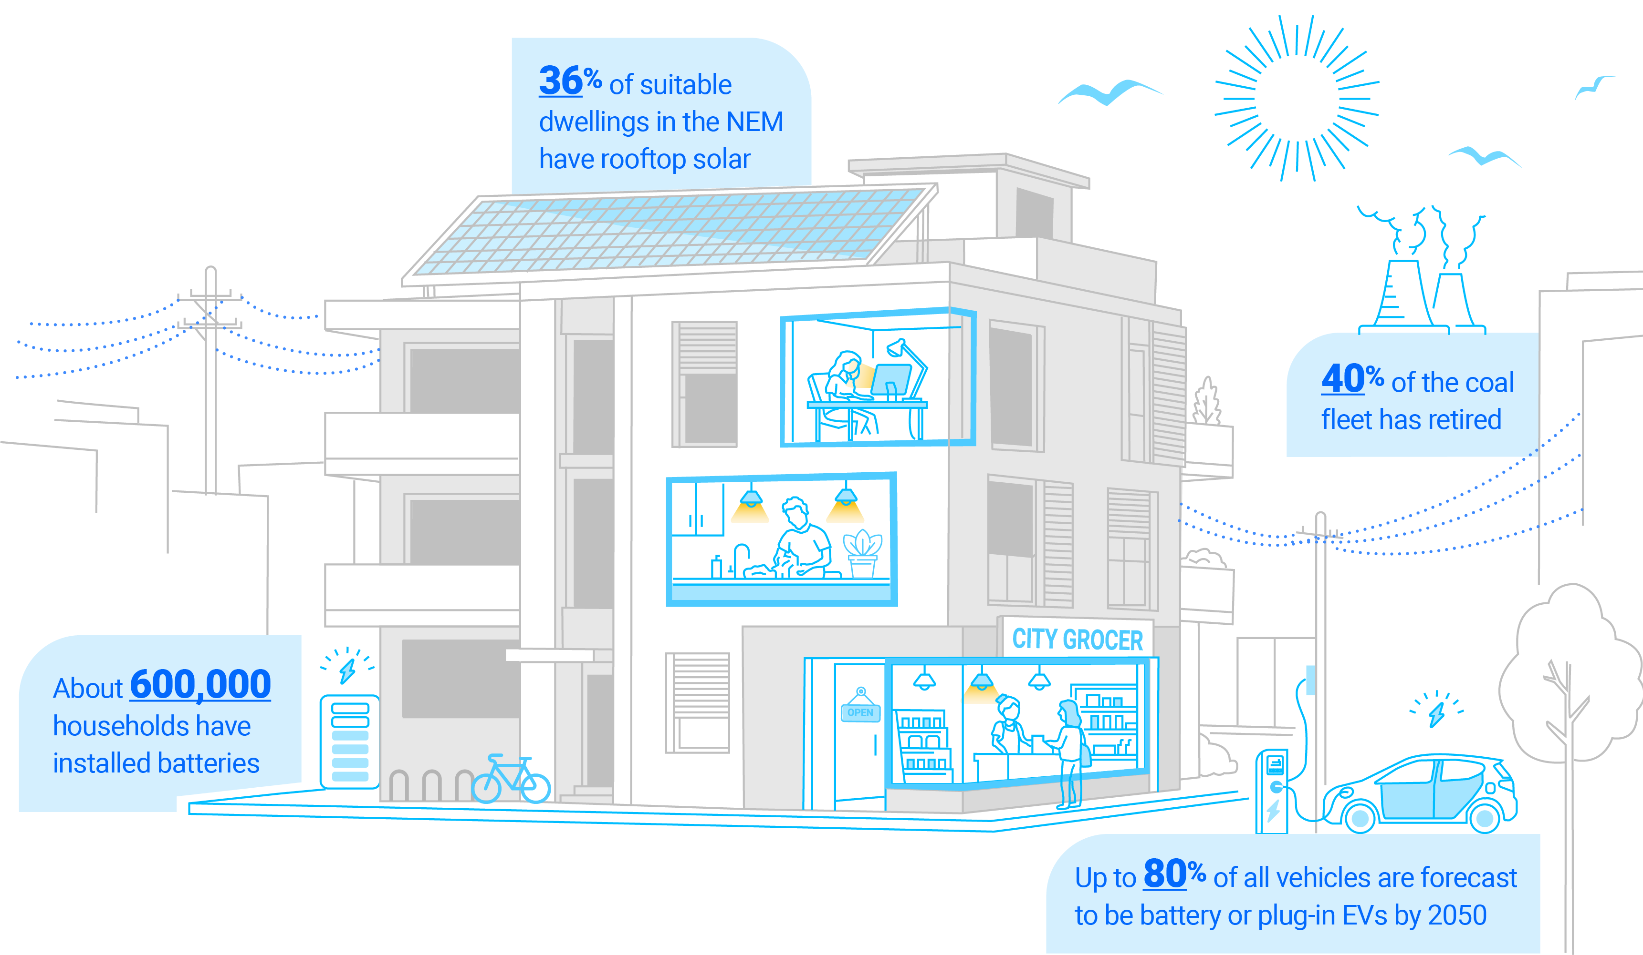
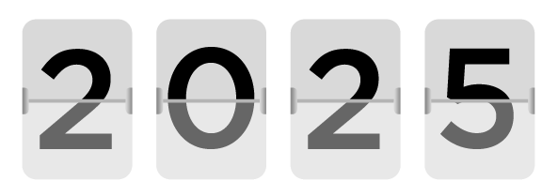
Australia’s transition is being led by consumer energy resources
Reliable, consistent and accessible data is fundamental to its success
4 October
Consumer resources met a record level of just over 60% of NEM energy demand
AI will play a central role in coordinating and optimising these resources

Slide 5
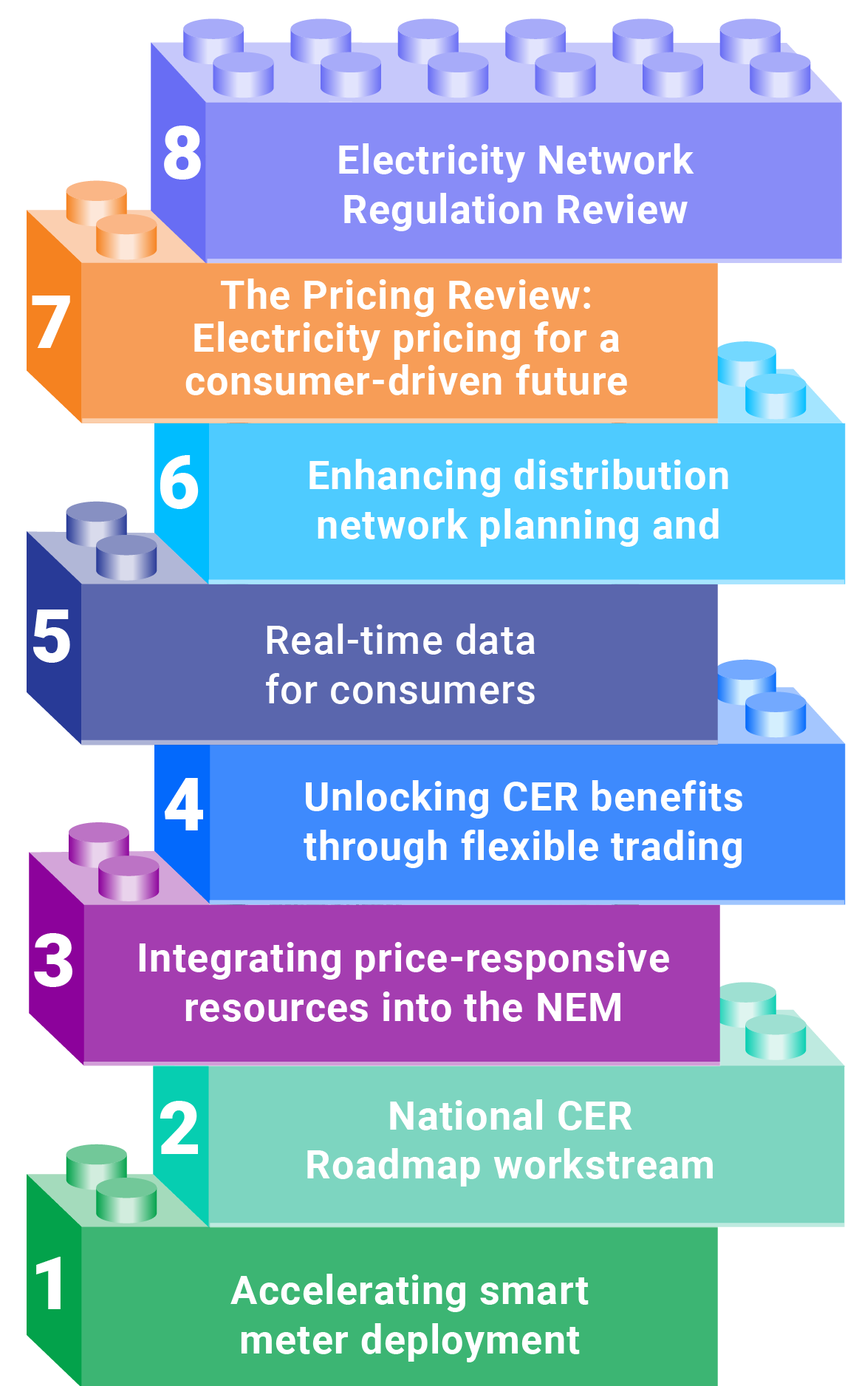
AI will be a critical enabler of AEMC reforms
Building the digital foundation to a more connected, modern and efficient energy system
Using AI to unlock the benefits of reform
Forecasting and coordinating CER.
Improving visibility across the system.
Managing two-way electricity flows.
Tailoring retail products.
Reducing unnecessary network investment;
Enabling virtual power plants and flexible demand to participate in the market.

Slide 6
Algorithmic bidding: benefits and emerging questions
Opportunities
Questions to understand
Faster, more responsive bidding
Better optimisation of batteries and flexible resources
Lower participation costs
More efficient market responses
Accountability and bid integrity
Competition and market behaviour
Information flows
Common technology providers
The AEMC will lead a review on algorithmic bidding in Australia’s National Electricity Market

Slide 7
The impact of AI on energy systems
Victoria Mollard
AEMC, Executive General Manager, Economics and System Security

